Slide 1
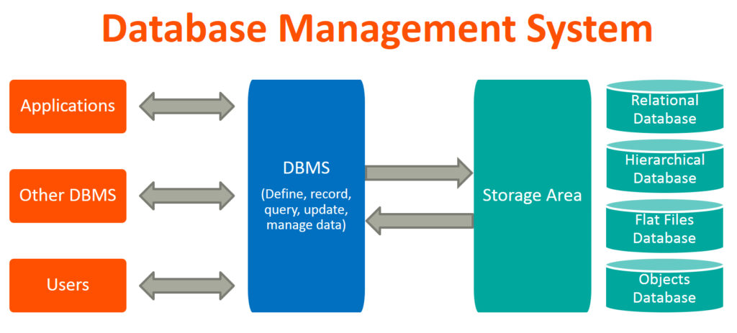
Database
Database is a systematic collection of data.
Database support storage and manipulation of data.
Database Management System (DBMS) is a collection of programs which enables us to:
access data, manipulate data, representation of data

Slide 2
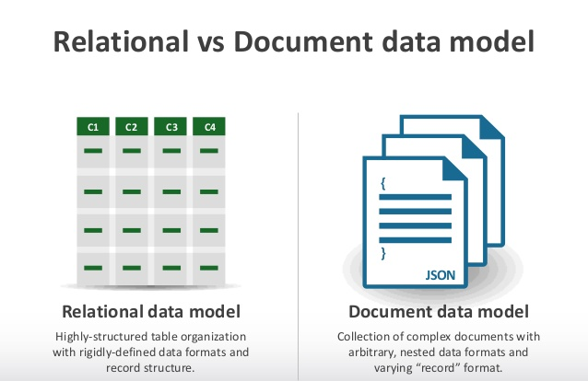
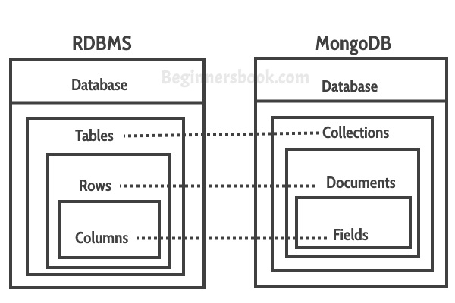

Slide 3
MONGODB
MongoDB is a No SQL database.
It is an open-source, cross-platform, document-oriented database written in C++.
Companies like Google, Flipkart, Facebook, Twitter, Bosch, Nokia, and MTV are all among the major users of MongoDB.

Slide 4
Why Mongo DB?
Development with ease is possible with mongo DB.
MongoDB is a document oriented database that provides
High performance
High availability
Scalability: It is based on distributed database, making it horizontally scalable.
Flexibility: The documents that are inserted are not checked against any schema, which makes the system flexible for handling variety of data.

Slide 5
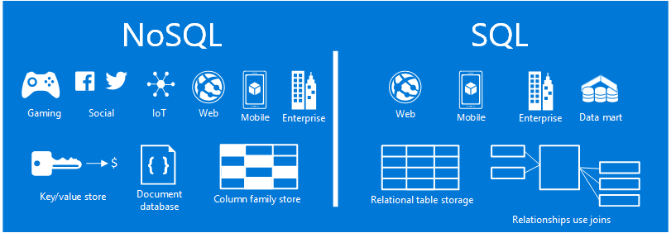
HIGH AVAILABILITY
Notes:
High availability -

Slide 6
Document(JSON) Structure
Data is stored in MongoDB in the form of JSON Style.
JSON is simple structure and very easy to understand the content.
JSON is smaller, faster and lightweight.
For data delivery between servers and browsers, JSON is a better choice
Easy in parsing and processing the data.

Slide 7
INSTALLATION OF MONGODB
To install mongoDB, go to this link and click on the appropriate OS and architecture: http://www.mongodb.org/downloads
Click on downloaded file and start installing.
After installation click on next till you get Finish button.
Create a data directory on C:\ for mongoDB to use i.e. “data” followed by “data\db”.
Open your mongodb/bin directory and run mongod.exe to start the database server.
To establish a connection to the server, open another command prompt window and go to the same directory, entering in mongo.exe. This engages the mongodb shell.

Slide 8
To Create Database
To Create a new db
use <name>
To check which db you’re using
db
To show all databases
show dbs
To show all collections
show collections

Slide 9
The insert() Method
To insert data into MongoDB collection, we use MongoDB's insert() method.
Syntax of insert():
db.COLLECTION_NAME.insert(document)
Example: db.hospital.insertMany([{"hId":"H2","name":"apollo"},{"hId":"H3","name":"medicover"}]);
db.hospital.insert({"hId":"H1", "name":"hedge"});

Slide 10
The find() Method
To query data from MongoDB collection, we use MongoDB's find() method.
Syntax of find() method:
db.COLLECTION_NAME.find()
find() method will display all the documents in a non-structured way.
To display the results in a formatted way, we can use pretty() method.
db.mycol.find().pretty()

Slide 11
Query Document using find()
Matching criteria
db.employees.find({"name":"raju"})
Greater than search criteria
db.employees.find({salary:{$gt:30000} })
Less than search criteria
db.employees.find({age:{$lt:30}})
in operator:
db.employees.find({age:{$in: [23,32]} })
Above command retrieves the documents from the employees collection where age equals either 23 or 32

Slide 12
and operator:
db.employees.find({name:"ram",age:22})
Above command retrieves the documents in the employees collection where the name equals “ram" and age is 22
or operator:
db.employees.find({$or: [{age:44},{salary:40000}]})
Above command retrieves the documents in the employees collection where age is 44 or salary is 40,000.
and with or:
db.employees.find({name:"ram",$or: [{age:22},{salary:38000}]})
Above command retrieves the documents in the employees collection where name equals ram and either age is 22 or salary is 38,000.

Slide 13
The update() Method
MongoDB’s update() method updates the values in the existing document.
db.COLLECTION_NAME.update(SELECTION_CRITTERIA,UPDATED_DATA)
db.COLLECTION_NAME.updateMany(SELECTION_CRITTERIA,UPDATED_DATA)
Example:
db.hospital.update({"hId":"H1"},{$set:{"name":"Apollo"}});
db.hospital.updateMany({"hId":"H1"},[{$set:{"name":"Apollo"}}]);

Slide 14
The delete()/remove() Method
MongoDB’s delete()/remove() method is used to remove a document from the collection.
db.COLLECTION_NAME.remove(DELLETION_CRITTERIA)
db.COLLECTION_NAME.deleteOne(DELLETION_CRITTERIA) db.COLLECTION_NAME.deleteMany(DELLETION_CRITTERIA)
Example:
db.hospital.deleteOne({"name":“apollo"});
db.hospital.deleteMany({"name":“apollo"});

Slide 15
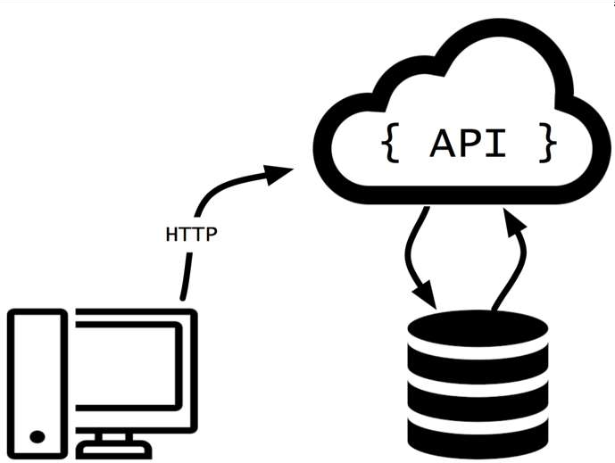
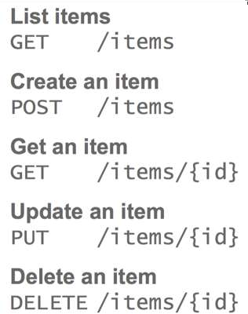

Slide 16
Getting Started with our Project
Problem Statement:
Inventory management of critical health care infrastructure including real time usage tracking has become inevitable following the current pandemic. This project aims at building an inventory tracking system for ventilators that allows authorized hospital users to input details of the available inventory and tag it as “occupied”, “available” and “in-maintenance”. The three status can also be updated using a secure API for real time usage metrics. The application should have the ability to also add any ventilator to a specific hospital and search ventilators which are available.

Slide 17
Database as hospitalManagement
Collection 2: Ventilator Details
Collection 1: Hospital Deatils

Slide 18
Collection 1: Hospital:
{
"hId":"H1",
"name": "Apollo hospital",
"location":"17.398644, 78.484334",
"address": "Plot No. 3-5-874/1 Near, Old MLA Quarters Rd, Hyderguda,Hyderabad,Telangana 500029",
"contactNo": "040-23231380“
}

Slide 19
Collection 2: Ventilators:
{
"hId" : "H1",
"ventilatorId" : "H1V5",
"status" : "occupied",
"name" : "Apollo hospital"
}

Slide 20
DATABASE CONNECTION IN nodejs with mongodb
var express= require('express');
var app=express();
const MongoClient=require('mongodb').MongoClient;
const url='mongodb://127.0.0.1:27017';
const dbName='hospitalInventory';
let db
MongoClient.connect(url, (err,client)=>{
if(err) return console.log(err);
db=client.db(dbName);
console.log(`Connected Database: ${url}`);
console.log(`Database : ${dbName}`);
});

Slide 21
API to be built:
1. Read Hospital and Ventilator Details
2. Search Ventilators by status and hosp name
3. Search Hospital by name
4. Update Ventilators Details
5. Add Ventilator
6. Delete Ventilator by Vent ID

